Slide 1
Summer of Journalism

Slide 2
Introduction

Slide 3
New England High School Journalism Collaborative
Summer Workshop (NEHSJC)
Free Week-long Journalism Intensive at Boston Globe & Regis College
Around 15-18 HS Students from MA
June 24-July 1, 2017
Open to ALL grades incl. Graduating seniors
Application Deadline: February 17, 2017
Copy of Published Newspaper
End-of-Week Six Flags NE Trip
nehsjc.org/summerworkshop

Slide 4
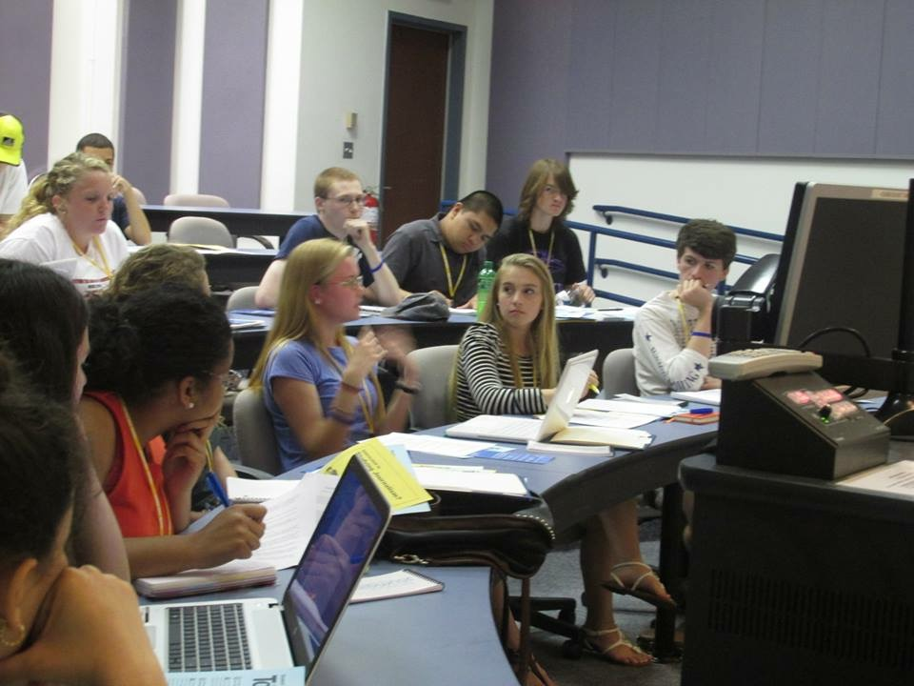
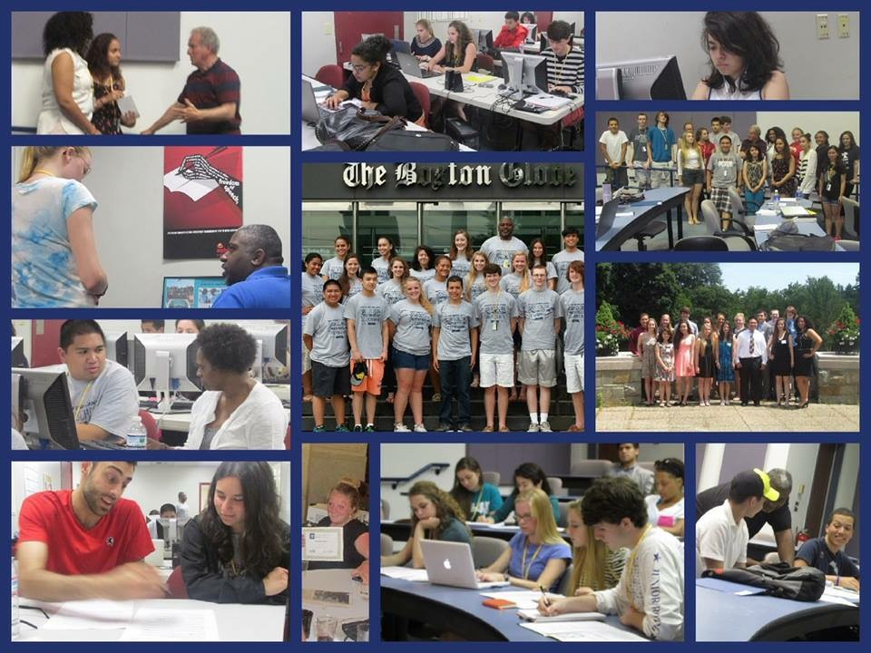
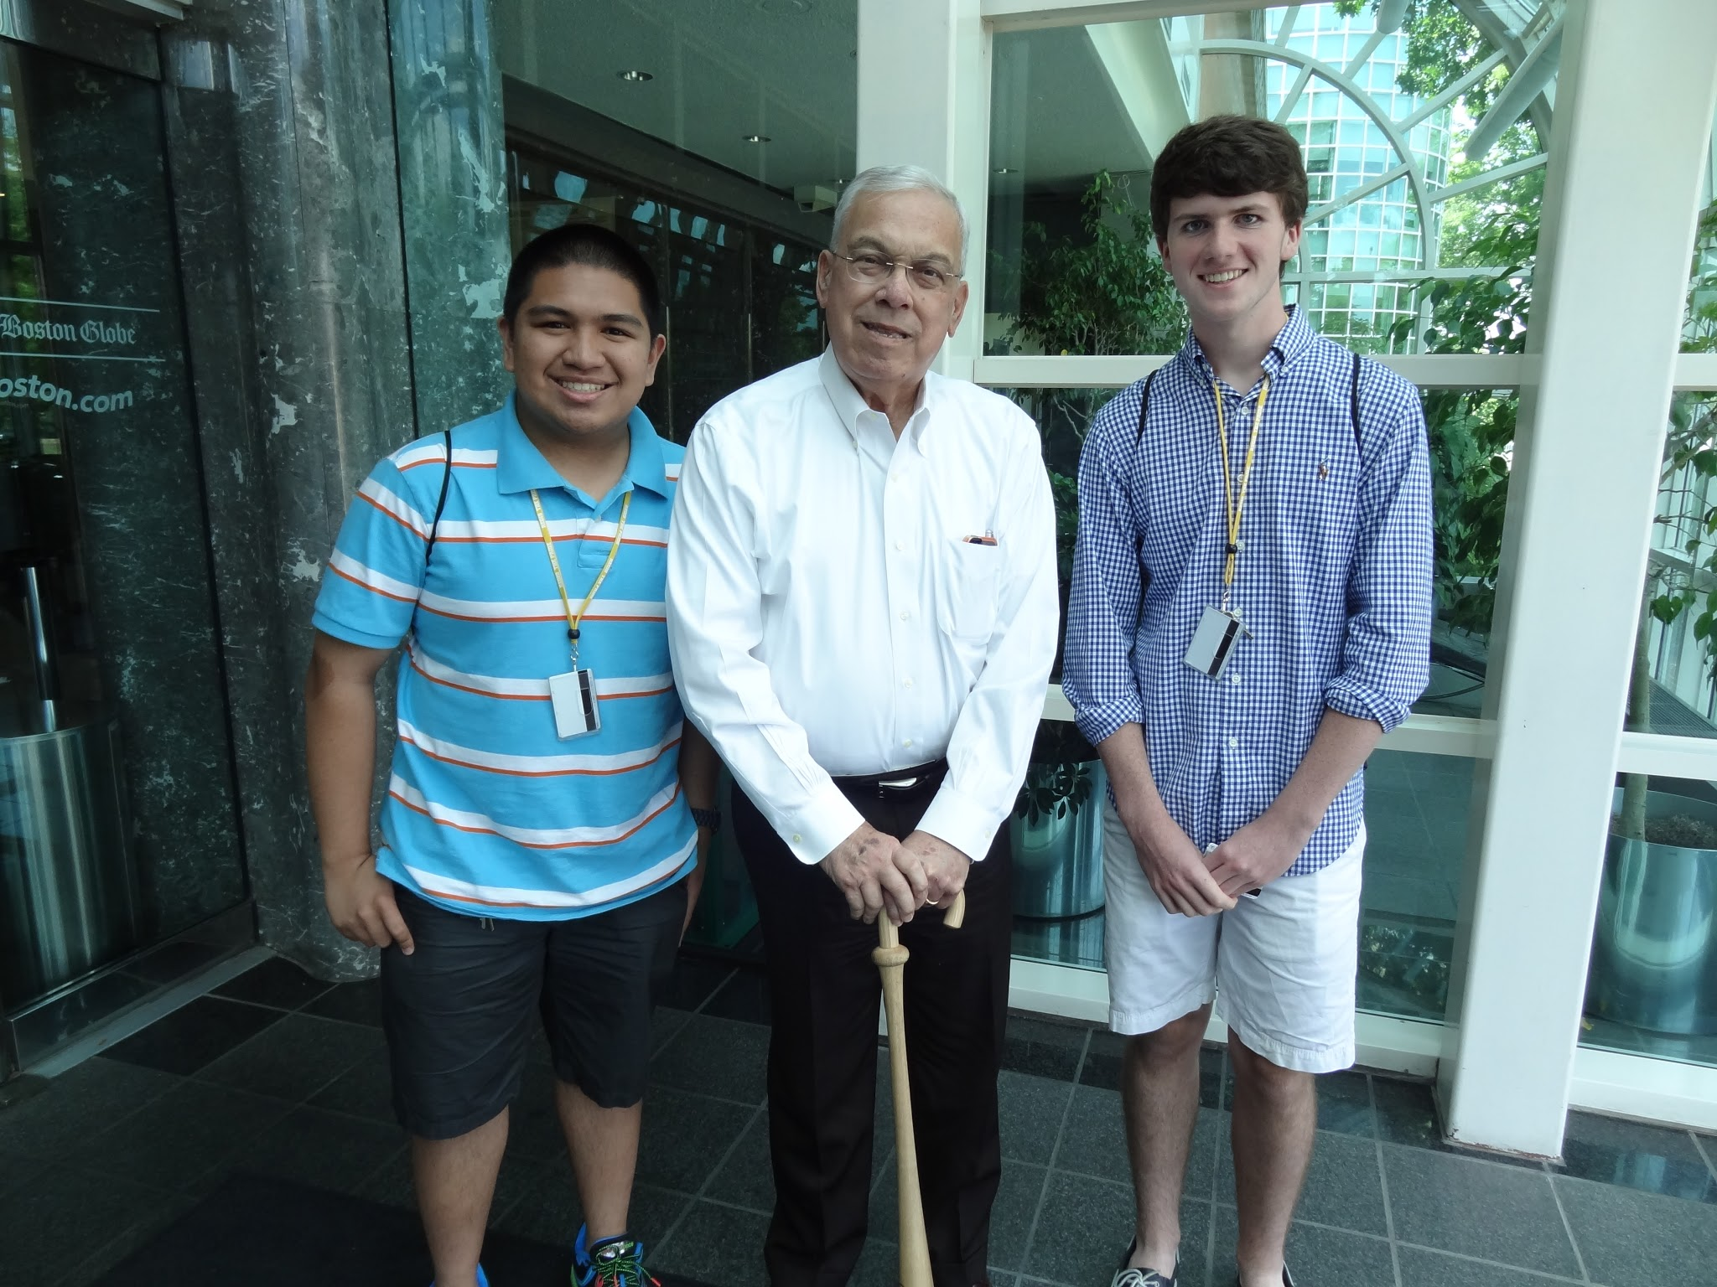
New England High School Journalism Collaborative
Summer Workshop (NEHSJC)
http://nehsjc.org/endeavor/

Slide 5
Washington Journalism and Media Conference (WJMC)
wjmc.gmu.edu
Week-long Journalism Conference at George Mason University in Washington, DC
Earn 1 College Credit from GMU + $2000/yr scholarship
July 9-14, 2017 & July 16-21, 2017
Cover all aspects of Journalism (Radio, Sports, Broadcast, Print, Politics, etc…)
$1965 excl. Flights, scholarships available

Slide 6
Washington Journalism and Media Conference (WJMC)
Places Visited:
Newseum
National Mall Monuments
National Press Club
White House
Capitol Hill (Includes Rep/Sen. Visit)
Smithsonian Museums
National Geographic

Slide 7
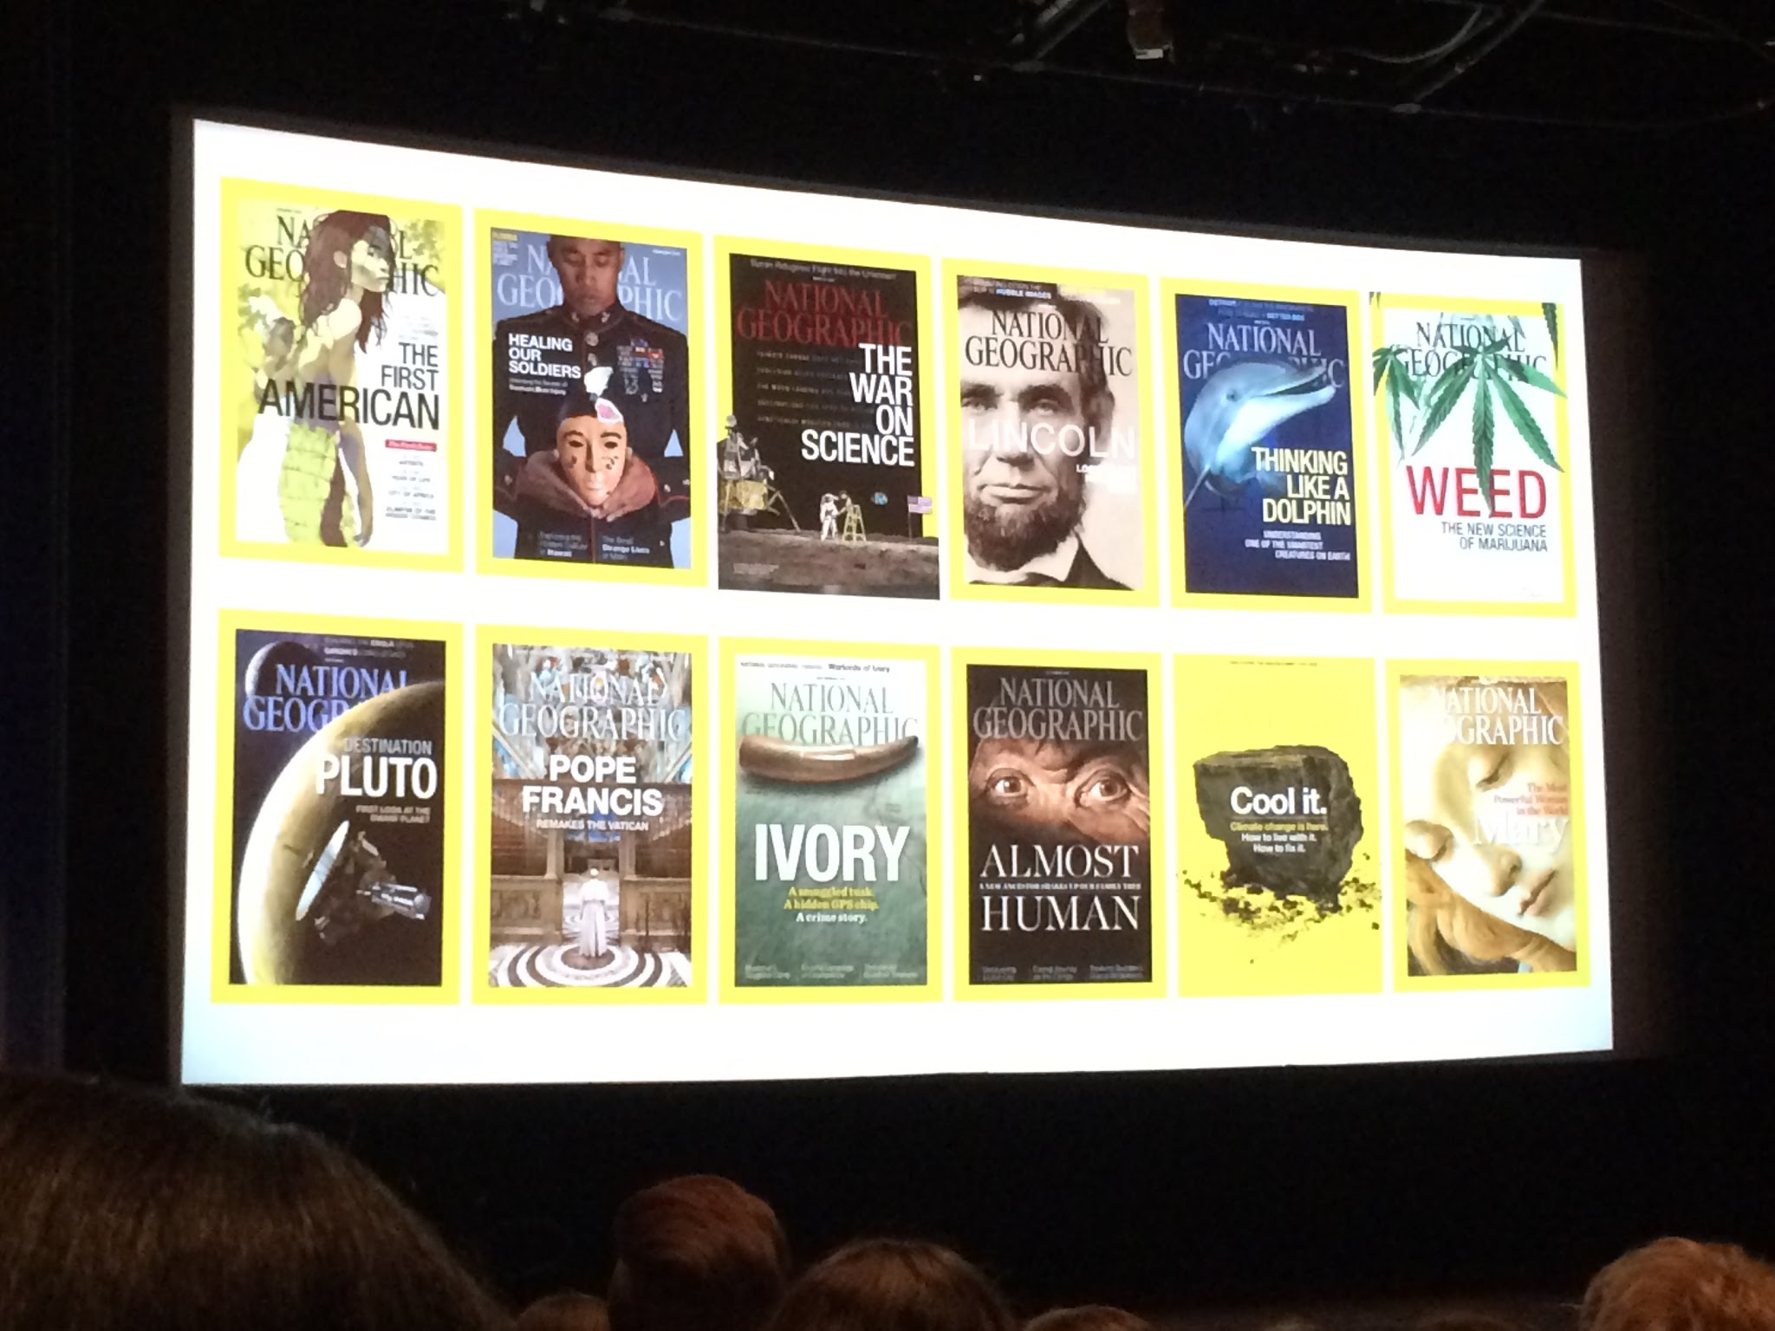
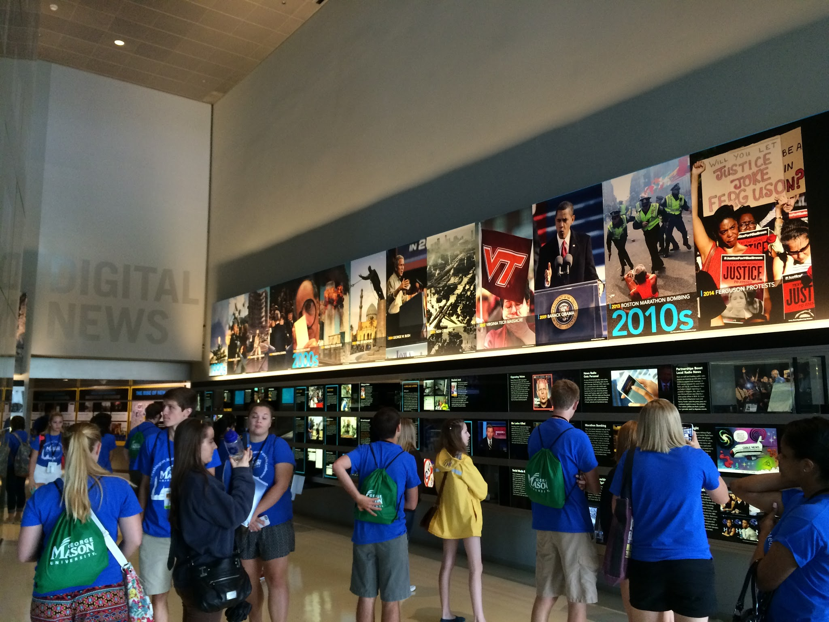
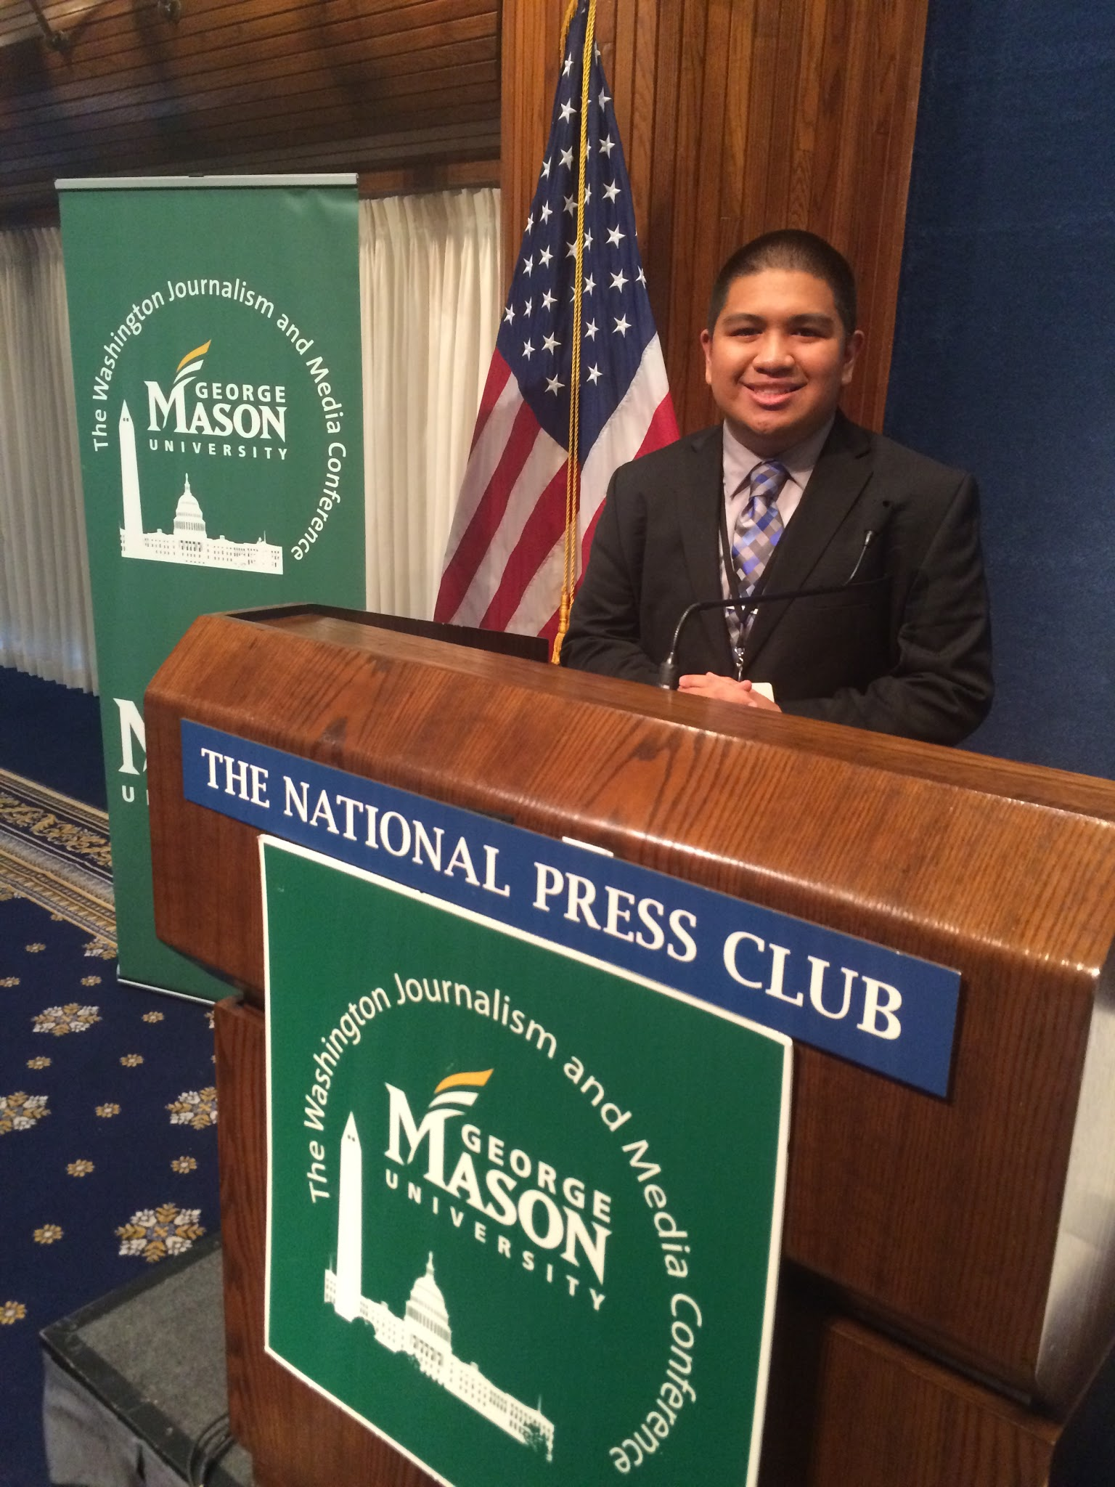
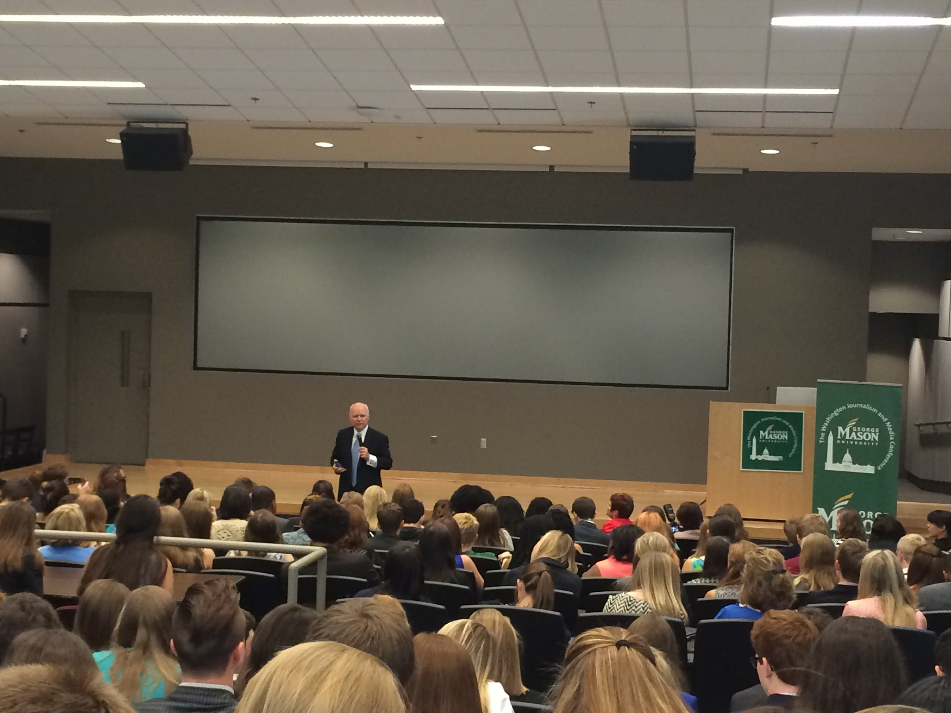
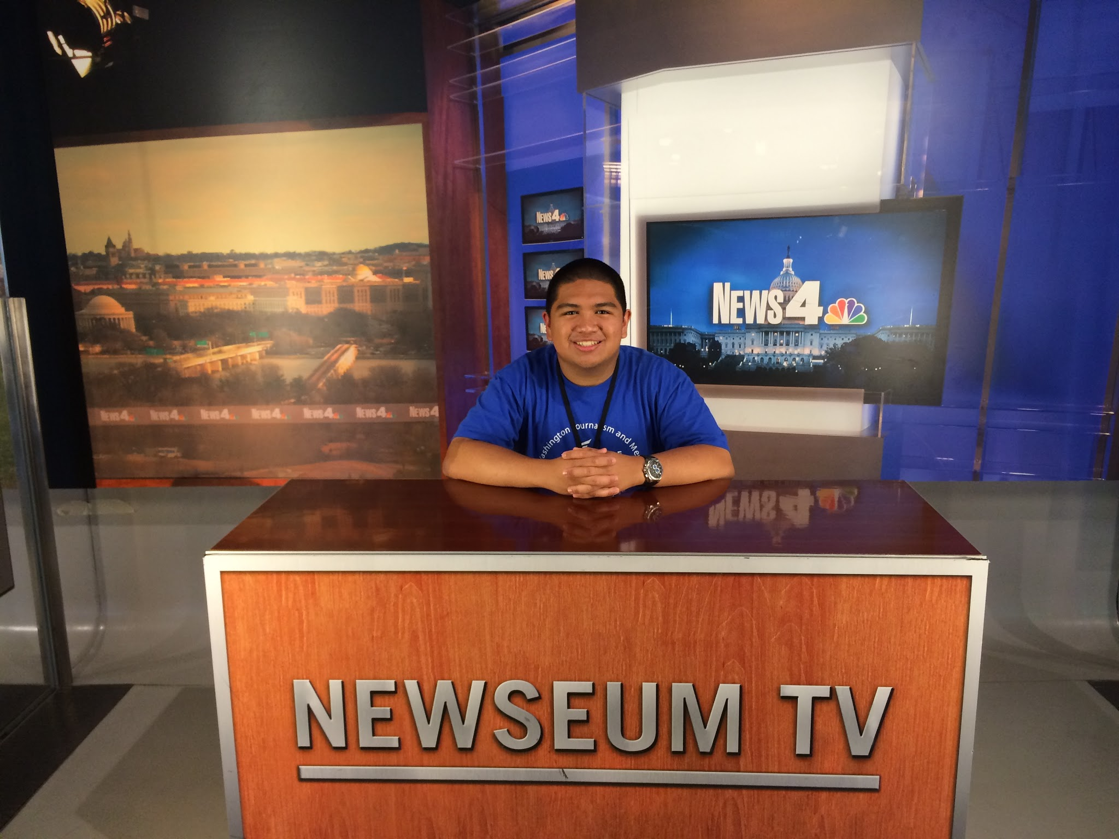
Washington Journalism and Media Conference (WJMC)

Slide 8
AAJA J- CAMP 2017
(Asian American Journalists Association)
Free Week-Long Summer Workshop Intensive at Temple University in Philadelphia
Free=Free, including travel and accommodations
Work with TOP journalists in the field
9th-11th grade
Applications Deadline: March 12, 2017
http://jcamplive.aaja.org/
http://www.aaja.org/category/journalism-programs/jcamp-high-school-program/

Slide 9
AAJA J- CAMP 2016
(Asian American Journalists Association)
People Met:
Richard Lui, MSNBC Anchor
Luther Campbell, 2 Live Crew Rapper
Joie Chen, Al Jazeera America “America Tonight” anchor
Neal Justin, Entertainment Columnist, StarTribune
Cristela Guerra, Boston Globe Living Arts Reporter

Slide 10
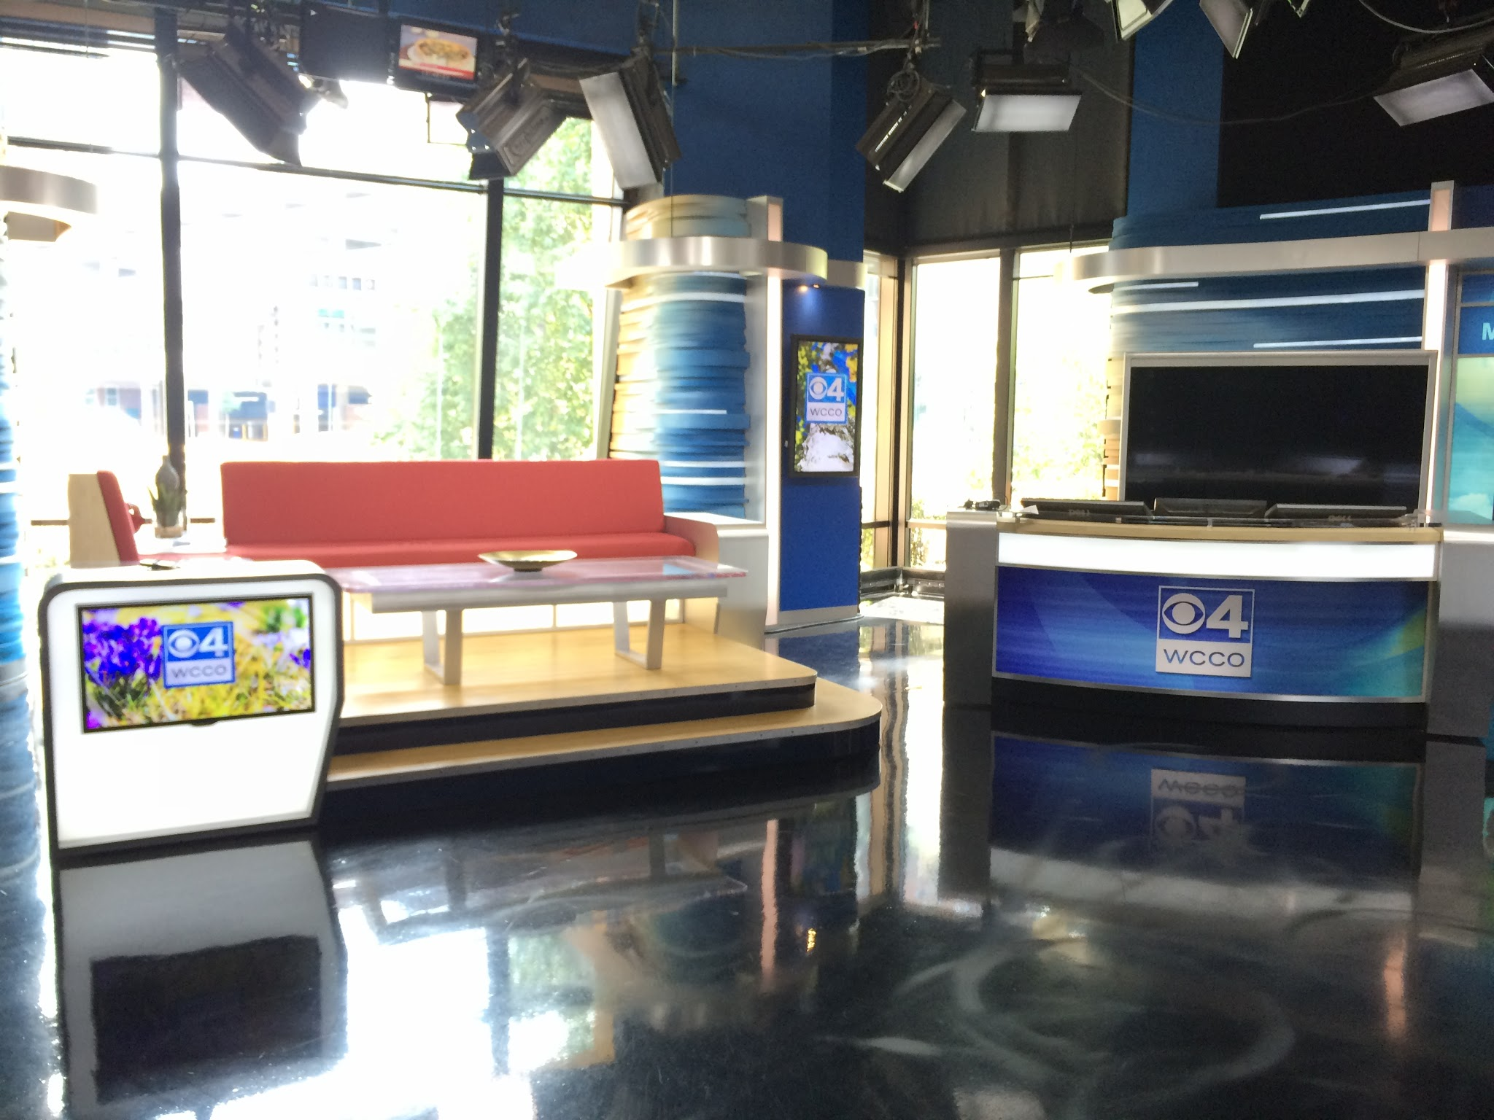
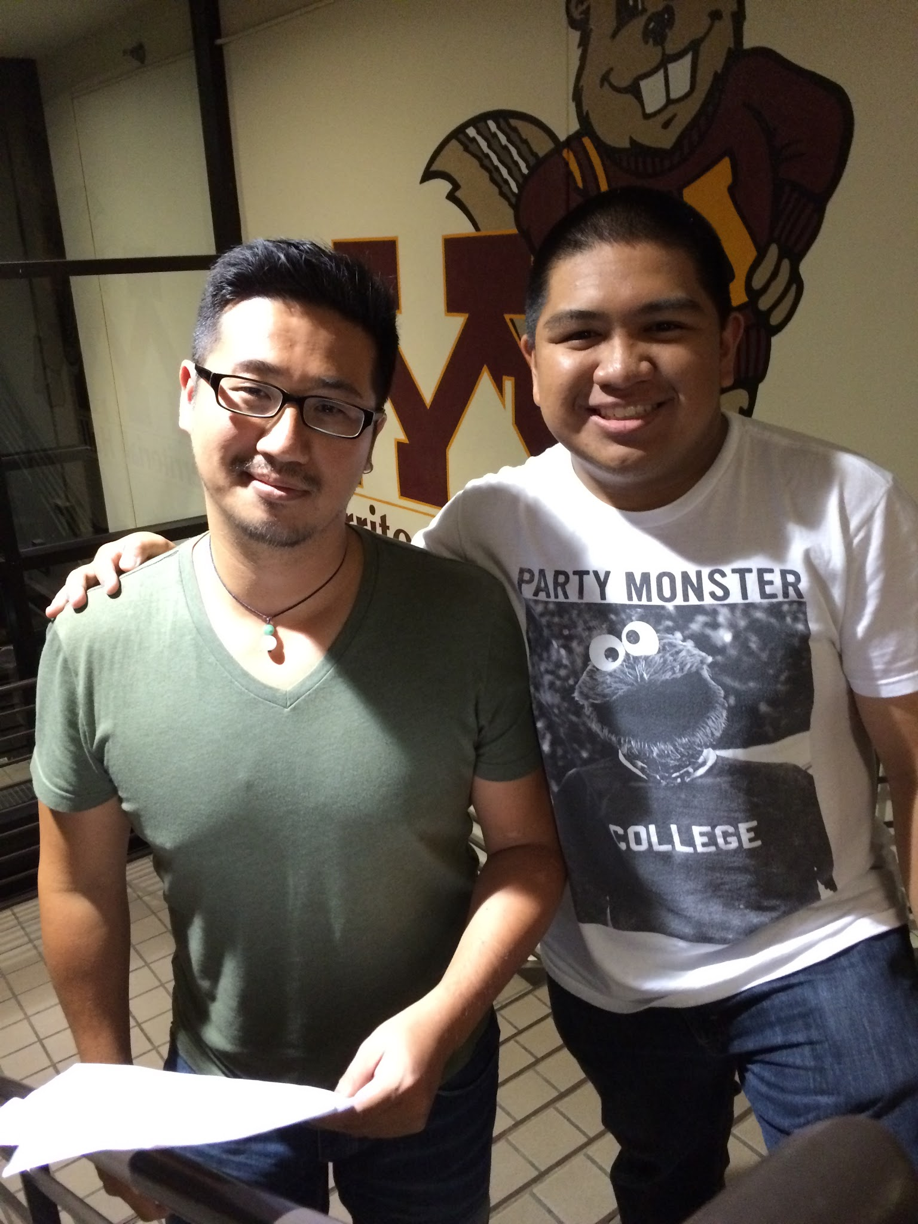
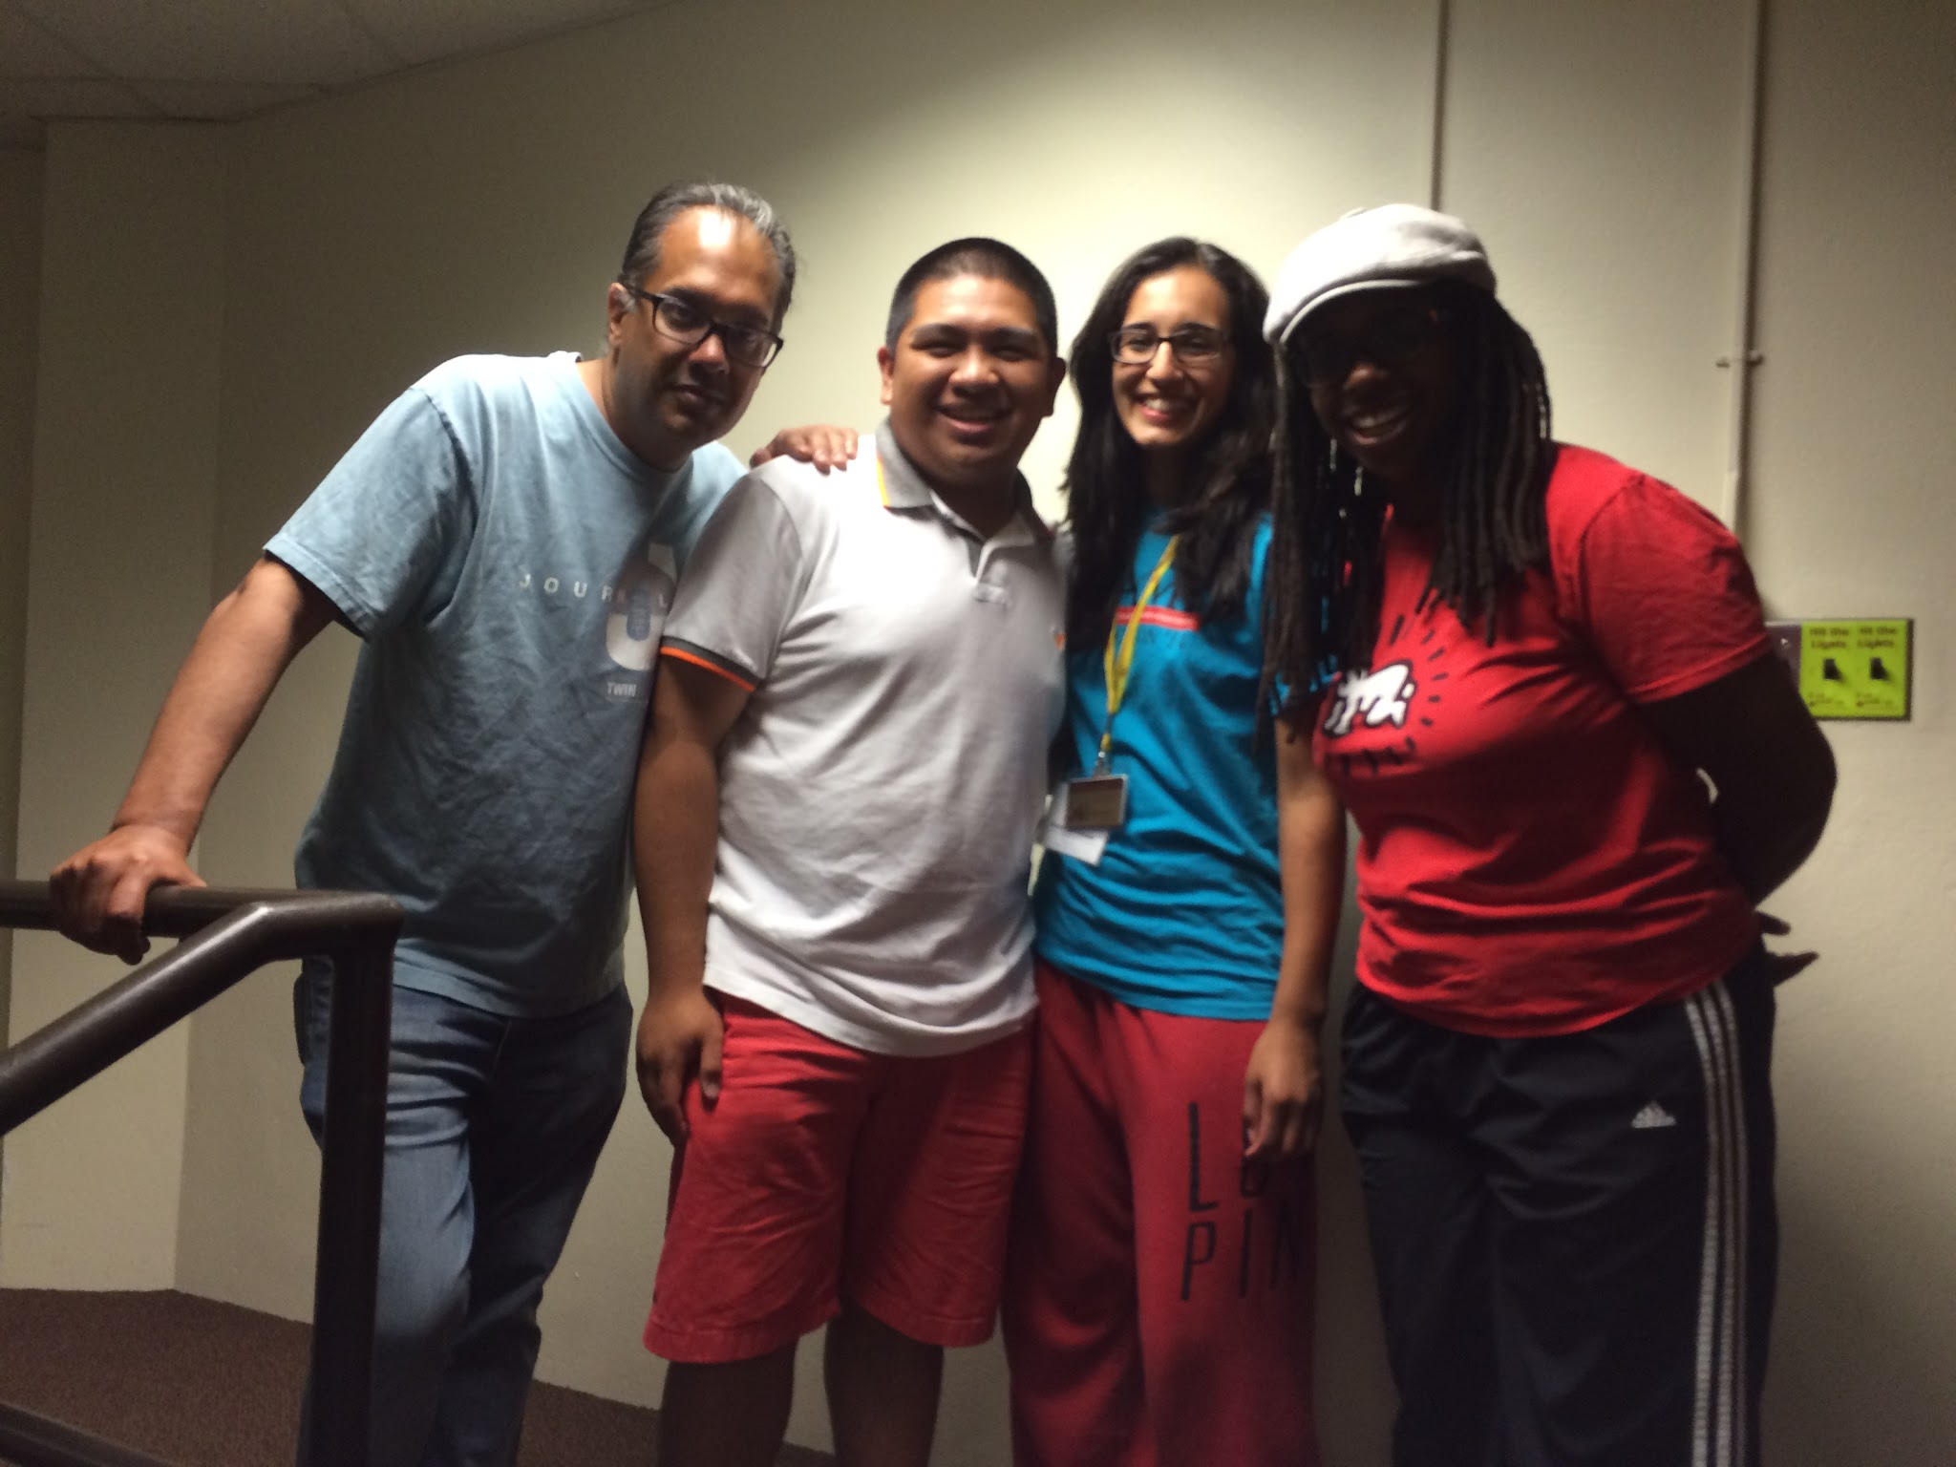
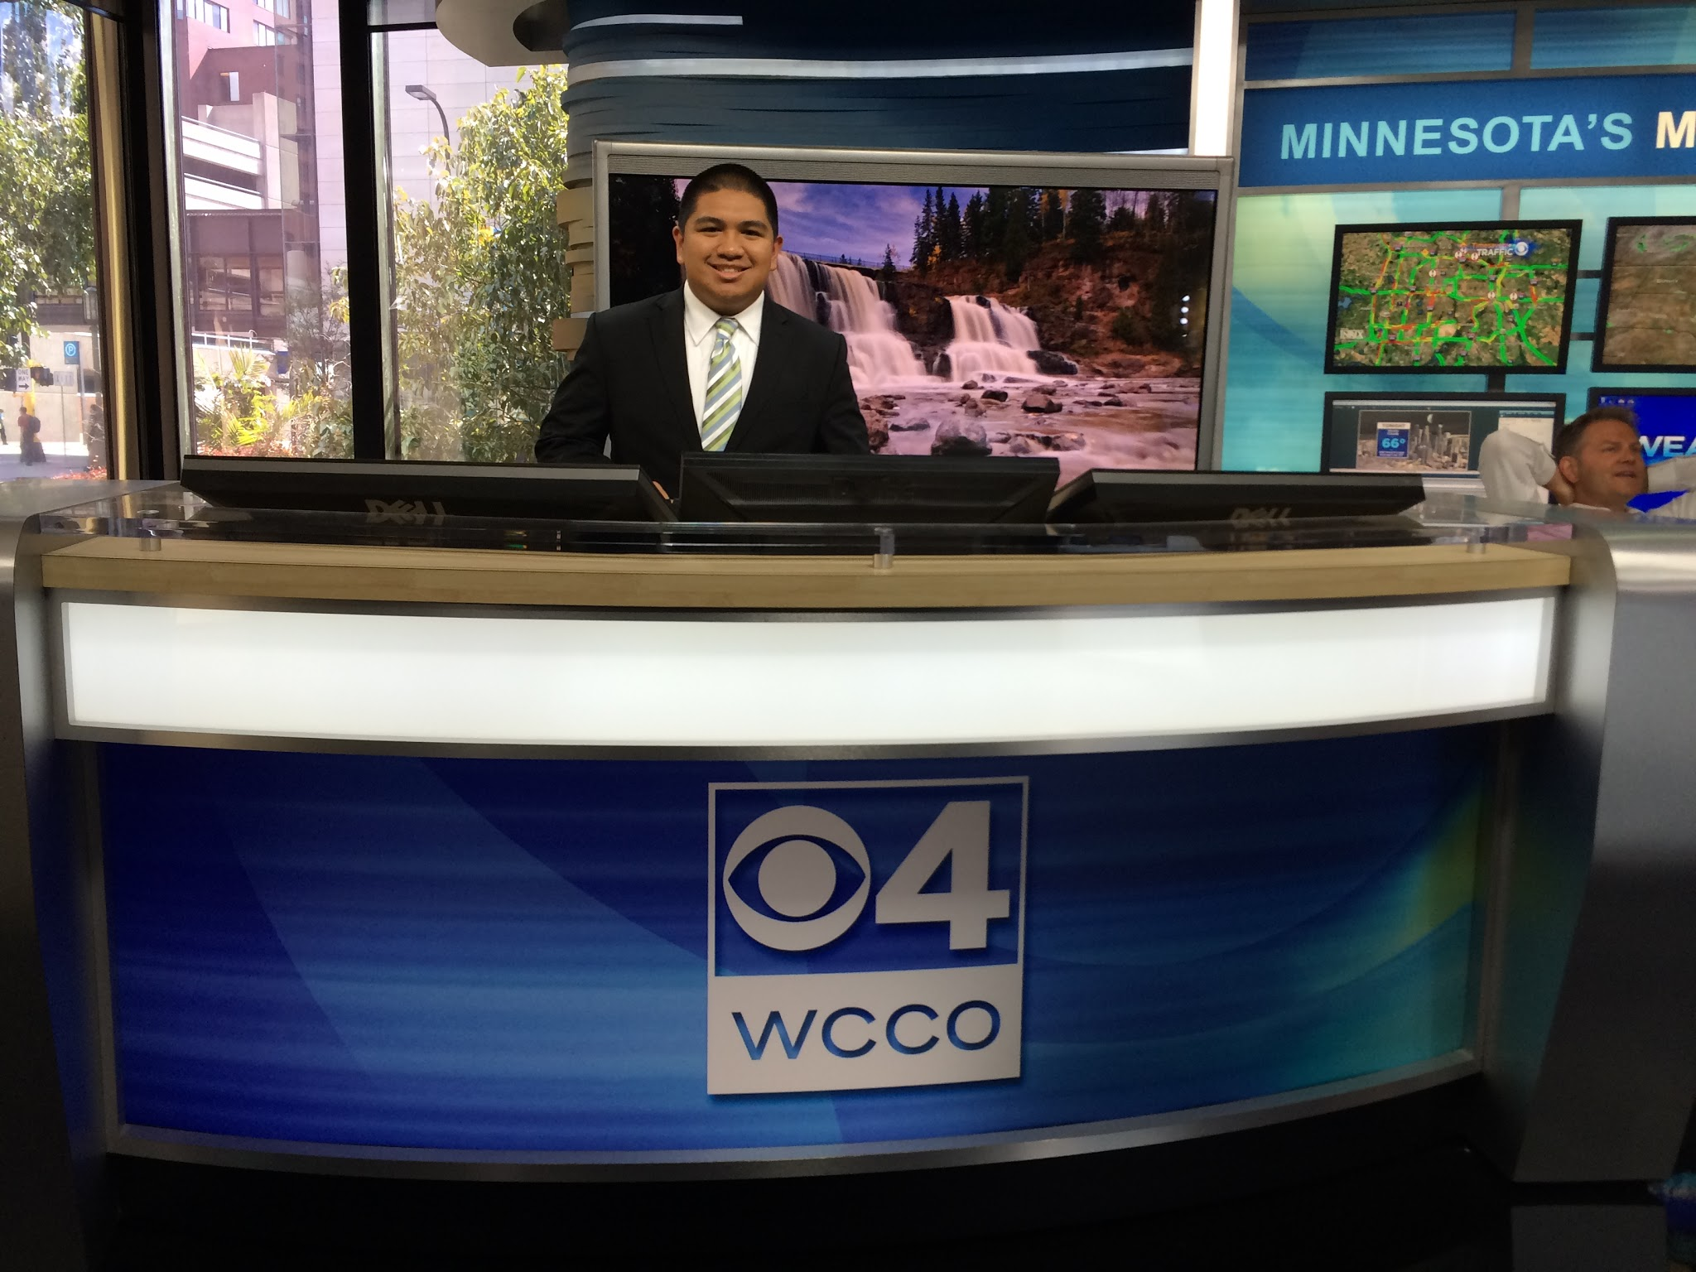
AAJA J- CAMP 2016
(Asian American Journalists Association)

Slide 11
Questions?

