Slide 1
THE INVERTED PYRAMID
Creating a News Story

Slide 2
The Inverted Pyramid
Journalists don’t want their stories told from the beginning of a news event.
They focus on the end result, and then may go back to the beginning.
They like giving away the ending.
They are more interested in the outcome.
News writing is about the only form of writing in which you start with the climax.
This story form is widely known as the inverted pyramid.

Slide 3
The Inverted Pyramid
The inverted pyramid style has been around for more than 100 years and is still going strong.
It is still widely used in newspapers and wire services.
It is the style of choice on many, if not most, online news sites, including the Chronicle, because many Web surfers have itchy mouse fingers -- it’s even easier to click a mouse than turn a page.
Here’s a visual on what an inverted pyramid story might
look like (from handout) …

Slide 4
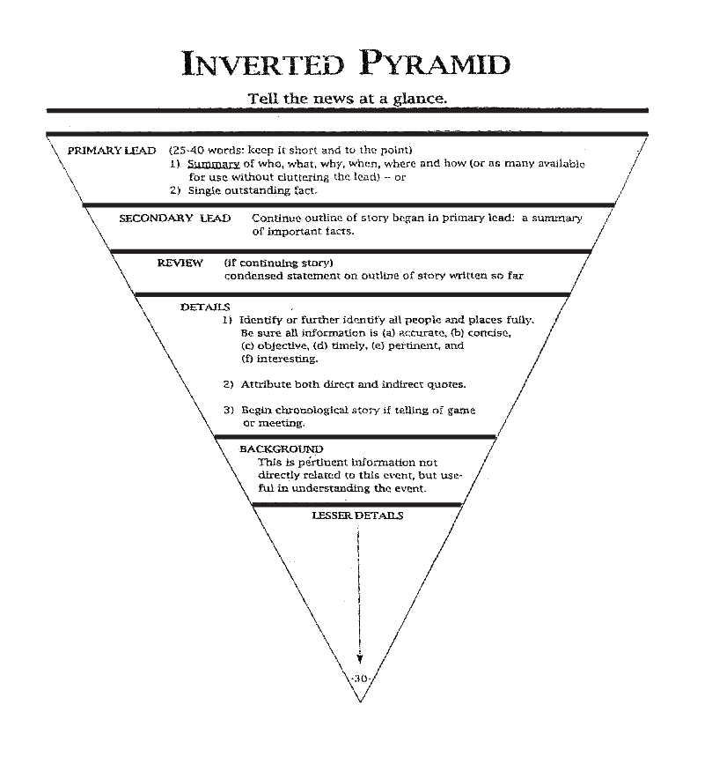

Slide 5
The inverted pyramid: Advantages
1. Offers quick reading
2. Features less repetition
3. Offers easier editing (easier to cut and paste)
4. Offers faster headline preparation
5. Easier to add to a story (as well as cut it)
6. Allows for faster writing of a story (can do it in your head, from a phone booth even)
7. Offers a quick organizing tool

Slide 6
How to do it
News writing is not like writing a theme for English class.
There’s no thesis sentence (well, there IS a nut graph)
There’s no conclusion.
The inverted pyramid is designed to help reporters put information in logical order.
It forces the reporter to rank, in order of importance, the information to be presented.
Just as there is a mental checklist for writing a lede, there
is also a checklist for writing the rest of an inverted pyramid
story:

Slide 7
The IP Checklist
The lede or lede device that directs the reader to the nut graph.
Introduce the additional important information that you were unable to put in the lede. This may be where the reporter introduces the “who,” the “why”, the “how” and the “what else happened” material.
If possible, indicate the significance, or the “so-what” factor

Slide 8
The IP Checklist
Elaborate on the information presented in the lede.
Give background on the issues, subjects, chronology of events, clarify conflict, etc.
Include information from all sides of an issue for fairness and balance. (If you have a GOP proposal, for example, get the Democratic response -- and vice versa.)
Continue introducing new information in the order you have ranked it. Don’t forget the “what happens next” angle if it’s significant.

Slide 9
The IP Checklist
Try to use the “one idea - one paragraph” method.
In newspapers and magazines that feature narrower column widths, the paragraphs are only one or two sentences.
The use of frequent paragraph breaks makes the typography less gray and is less formidable to the reader.
Type on the Internet is often narrow as well – so they can put all those ads on the side of the story.

Slide 10
A short exercise
Assemble these paragraphs into an inverted pyramid story. The
dateline is Austin. Simply arrange by the appropriate letter:
A. David Bailey, homeland security division chief for the Austin Fire Department, said nine workers from the mailroom where the letter was processed were quarantined until tests could determine whether the powder was toxic.
B. The mailroom is in the State Insurance Building.
C. Gov. Rick Perry's office said the letter came from a prison inmate but provided no other details. The substance was sent to the Texas Department of State Health Services for testing.
D. Bailey said none of the workers became ill.
E. Authorities evacuated a state office building on Wednesday after a suspicious powder was found in a letter sent to the governor's office.

Slide 11
A short exercise: How it ran (e, a, c, d, b)
AUSTIN — Authorities evacuated a state office building
on Wednesday after a suspicious powder was found in a
letter sent to the governor's office.
David Bailey, homeland security division chief for the
Austin Fire Department, said nine workers from the
mailroom where the letter was processed were quarantined
until tests could determine whether the powder was toxic.
Gov. Rick Perry's office said the letter came from a
prison inmate but provided no other details. The substance
was sent to the Texas Department of State Health Services
for testing.
Bailey said none of the workers became ill.
The mailroom is in the State Insurance Building.

Slide 12
How to end
Some writers feel a compulsion to make their last graph
some sort of happy ending (They may have lost today, but
the Cougars will try again next week…).
Resist the urge. In general, when the story’s over, stop.
Many news writers find useful or creative ways to divert
from the strict inverted pyramid style – they put a good
quote at the end to serve as a “closer” or maybe they save
a juicy fact or observation that’s low on the importance
scale.

Slide 13
How to end: Example
Check this nice touch as an end graph to a story on the
commissioning ceremony for the submarine USS Texas:
The veterans, crew, families and other guests enjoyed a light lunch after the ceremony under a giant pavilion. They were served sodas, chip, and – of course – submarine sandwiches.

Slide 14
How to end
Another possible option is to use the what’s next angle as a closer.
The bill now goes to the Senate, where it faces stronger opposition. A vote there is expected Thursday.
These techniques are fine, but if you are going to put
something vital at the end, then you better warn your
copy editors because they often look at the end of a
story to make their first cuts.

