Slide 1
News Writing
Inverted Pyramid
The Inverted Pyramid of news suggests that news be told in order of most interesting or important to least interesting or important
Most interesting or most important
Least interesting or least important

Slide 2
News Writing
Most Important
or Interesting
Least Important
or Interesting
Pressconnects.com

Slide 3
News Writing
Jack and Jill went up the hill to fetch a pail of water.
vs.
Jack suffered a skull fracture and Jill is in serious condition after the pair tumbled down a hill during their ritual water-carrying chores yesterday.

Slide 4
News Writing
The Newark Valley boys’ baseball squad played a game yesterday afternoon.
vs.
The Newark Valley boys’ baseball squad beat Candor at home yesterday in a thrilling extra-inning showdown between neighboring rivals.

Slide 5
Lead Writing
Most journalists think the news lead is the most important part of the news story. It is an art work of concise information that captures the gist of a news story in one or two sentences.

Slide 6
Lead Writing
Depending on the nature of the story and its driving news elements, a lead can focus on one or a few of the six question words:

Slide 7
Lead Writing
Hat Banning: One Story, Six Possible Leads
Who? — The Newark Valley Board of Education members passed a resolution last night banning the wearing of hats in all school district buildings.
What? — Hat wearing was banned in all school district buildings last night after the Newark Valley Board of Education passed a new resolution.

Slide 8
Lead Writing
Where? — In Newark Valley last night, the board of education passed a resolution to ban the wearing of hats in all school district buildings.
When? — Last night, the Newark Valley Board of Education passed a resolution banning hat wearing in all school district buildings.

Slide 9
Lead Writing
How? — By a 6-1 margin last night, the Newark Valley Board of Education passed a resolution banning hat wearing in all school district buildings.
Why? — Citing a pattern of early-onset baldness in Newark Valley teenagers, the board of education last night passed a resolution that restricts hat wearing in all school district buildings.
Pressconnects.com

Slide 10
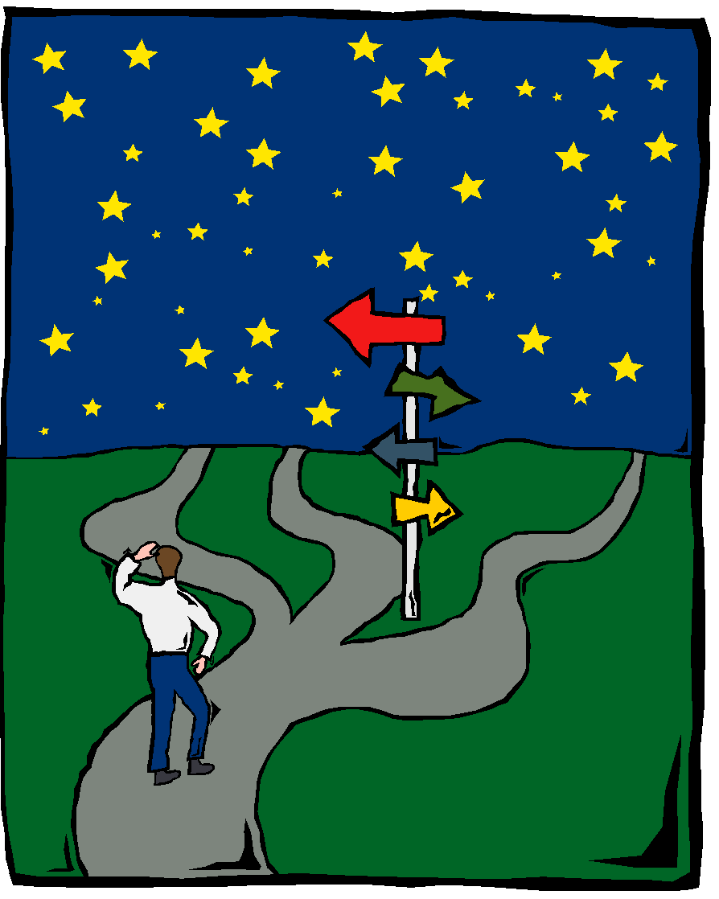
Lead Writing
Too Many Choices?
For local news, which is what we will be writing, it is important to know that most readers want to know news in this order:

Slide 11
Lead Writing
1. What happened and what will happen next?
2. Who was involved?
And then…
• When? • Where?
• How? • Why?

Slide 12
Try Your “Lead” Hand
Senior Scholar Night at Newark Valley last night. About 250 people showed up. Seniors who applied for and won scholarships were called up to the stage to accept their awards. 7 seniors won scholarships of $1,000 or more and 13 more earned scholarships of at least $500. Punch and cookies were served in the cafeteria after the event, which lasted from 6 until 8:30 p.m. It is the third straight year Newark Valley held such an event. “It’s become quite a nice evening for parents and teachers and students to get together to celebrate the accomplishments of our young men and women.” That statement was taken from Mrs. Grant, who is the superintendent of schools.

